Slide 1


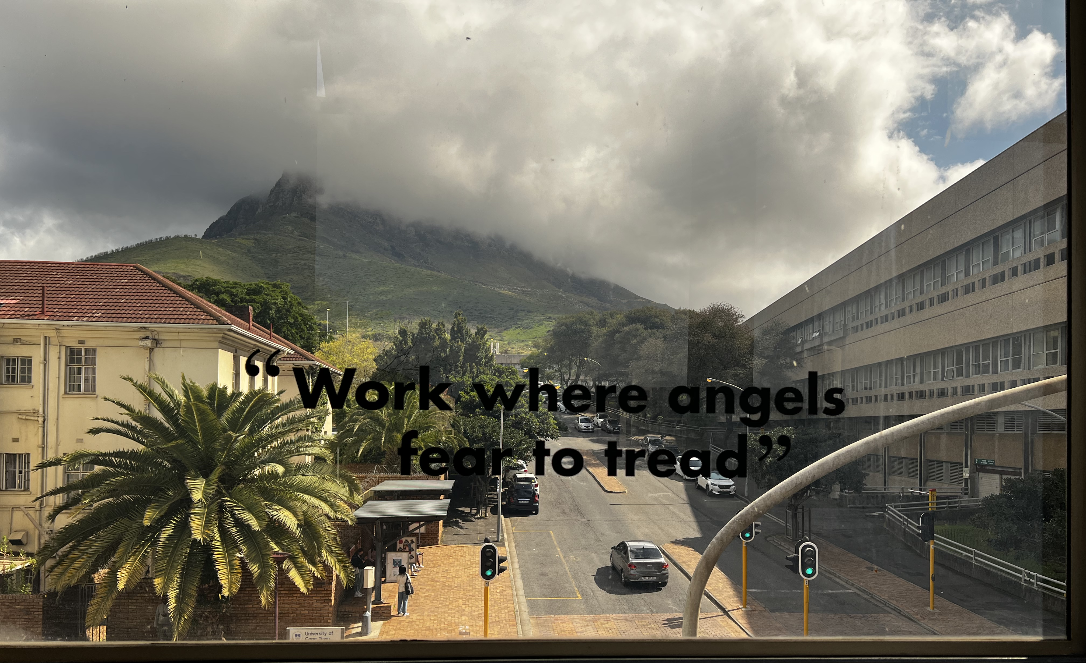
“Endohepatology:
Emerging Concepts for the Gen Z Gastroenterologists”
Dr Dominic Mutura
MPhil Gastroenterology (UCT), Cert Gastroenterology (Phys) (CMSA),

Slide 2
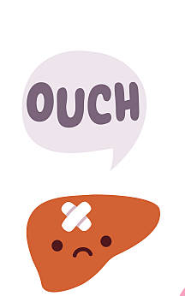
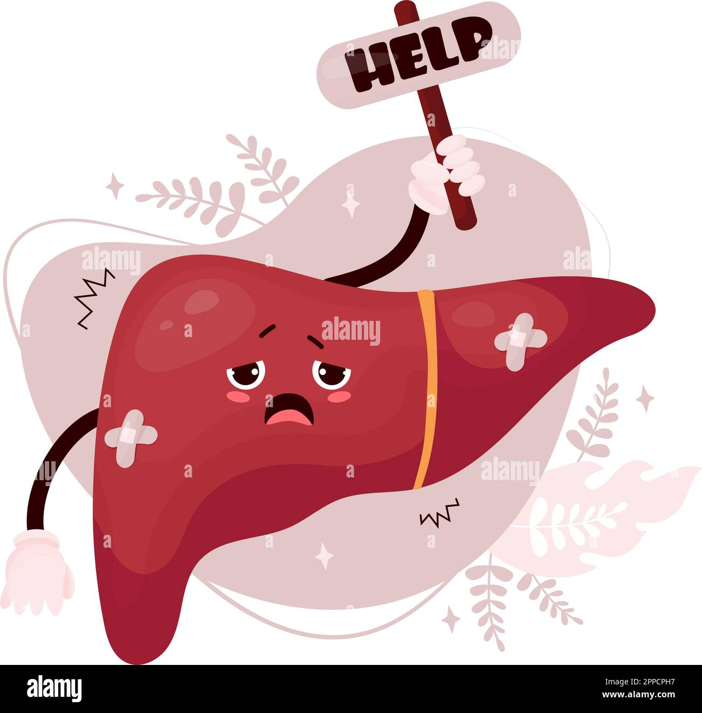
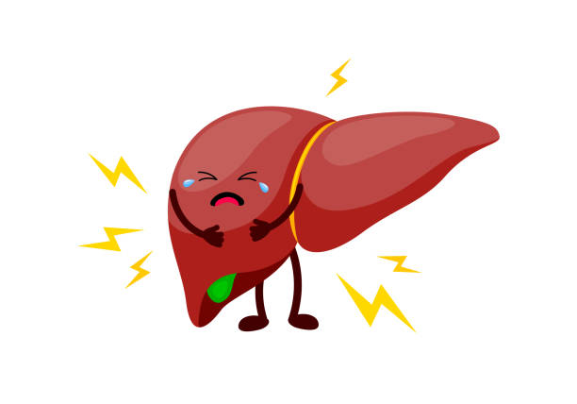
IT TAKES TWO TO TANGO
Years ago, a publication in Gut- esteemed journal stated that “....the liver is a stupid organ.
It has only limited abilities to express itself, i.e., become fat, necrotize, swell, inflame, clot and scarify.
The liver can become leaky, it can sometimes hurt and its plumbing can clog...
The liver, often harmed by persistent alcohol use, metabolic syndrome, viral hepatitis, or other liver-related dangers, not only poses a major health concern for individuals but also represents a worldwide health challenge, given that it is responsible for over 2 million deaths each year (which is one in every 25 fatalities).

Slide 3
Definition of Endohepatology
Integration of advanced endoscopy into hepatology practice
Uses EUS, ERCP, and advanced imaging to diagnose and treat hepatic and biliary diseases
Minimally invasive approach
liver parenchymal,
vascular, and
biliary disorders
Enables one‑stop combined diagnostic and therapeutic sessions
Vanderschueren et al., Gut 2025

Slide 4
Liver parenchyma | Evaluation of liver parenchyma
 | Transient elastography
 | EUS guided tissue acquisition
Vascular | Portal Pressure measurement
 | EUS guided variceal obliteration
Future | EUS guided TIPS
 | Portal blood sampling

Slide 5
Applications of Endohepatology
EUS‑guided liver biopsy (EUS‑LB)
EUS portal pressure gradient measurement (EUS‑PPG)
EUS shear‑wave elastography (EUS‑SWE)
EUS‑guided biliary drainage
EUS‑guided variceal therapy (coil + glue)
Portal vein sampling and metabolic profiling
Endoscopic bariatric and metabolic therapies (EBMT)

Slide 6
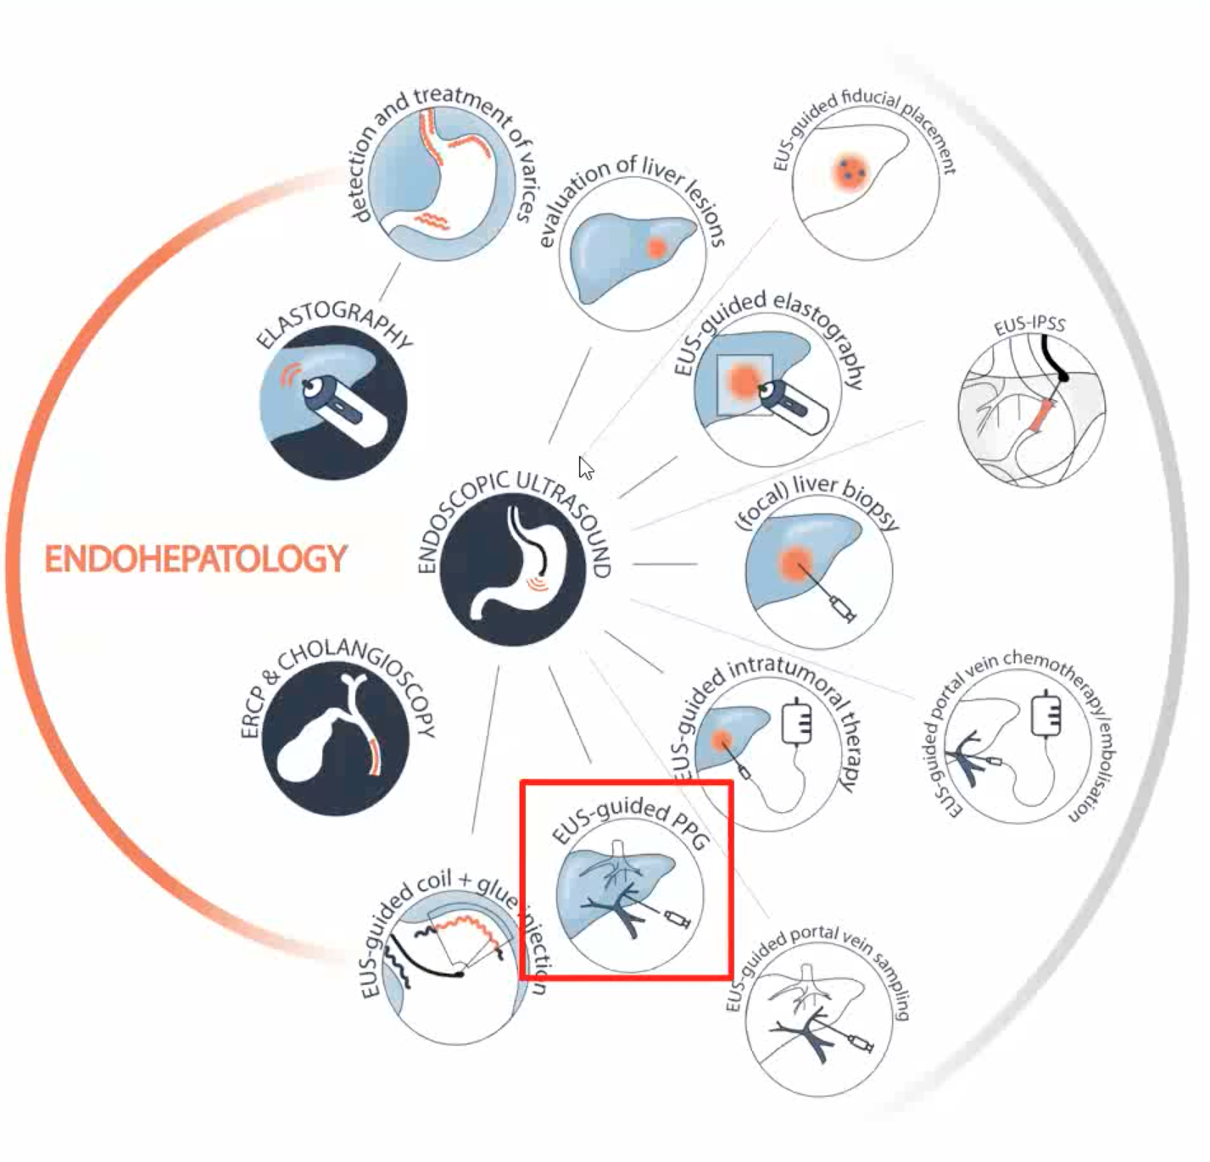

Slide 7
EUS-Guided Liver Biopsy

Slide 8
Technical Advances & Diagnostic Performance of EUS-LB
EUS-guided liver biopsy (EUS-LB) is an effective alternative to percutaneous and transjugular routes, offering comparable or superior diagnostic yield.
Optimal specimen quality depends on technical factors:
Needle: 19G FNB Franseen type.
Technique: “Wet heparinised” suction (WEST), saline-prefilled syringe, heparin-flushed needle.
Jabbing style: 3–4 actuations using a to-and-fro “fanning” motion over 3–4 cm.
Tissue retrieval: Sieve/cassette with saline flush to clear blood and allow rapid assessment.
Enables bilobar sampling, improving representativeness and reducing sampling error.
Mony et al., Gut 2025; Facciorusso et al., 2023

Slide 9
Clinical Advantages, Safety & Cost Considerations
Real-time ultrasound guidance allows precise needle placement, avoiding vascular structures and improving safety.
Low complication rate (<3%), most commonly minor self-limited bleeding.
Sedation-based procedure with shorter recovery time (≈30 min vs 4 hours for percutaneous).
Particularly advantageous in morbidly obese patients where percutaneous access is limited.
Cost-comparable to percutaneous biopsy (≈€2447 vs €2494) with similar QALYs.
Facilitates same-session procedures (e.g., EUS-PPG) and same-session bilobar biopsies, increasing yield without added risk.
EUS is superior to CT for detecting and sampling small metastatic lesions.

Slide 10
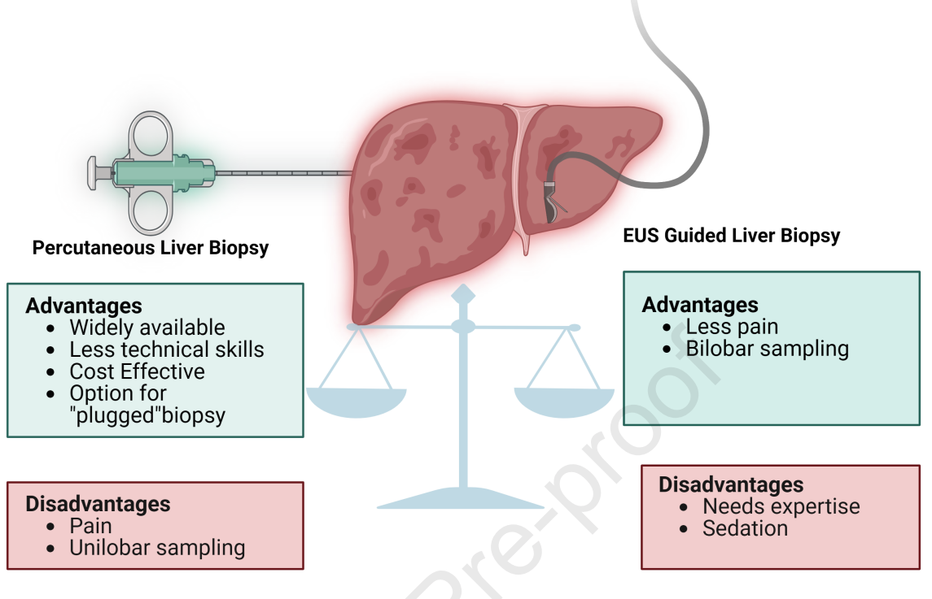
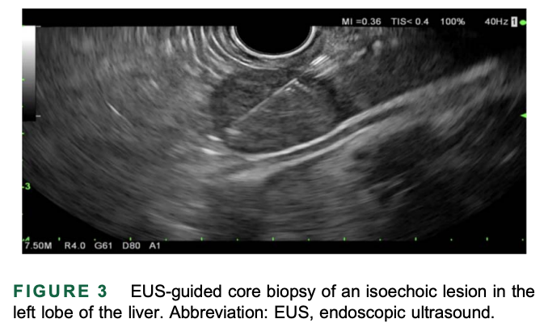
EUS-Guided Liver Biopsy

Slide 11
EUS Portal Pressure Gradient (EUS‑PPG)

Slide 12
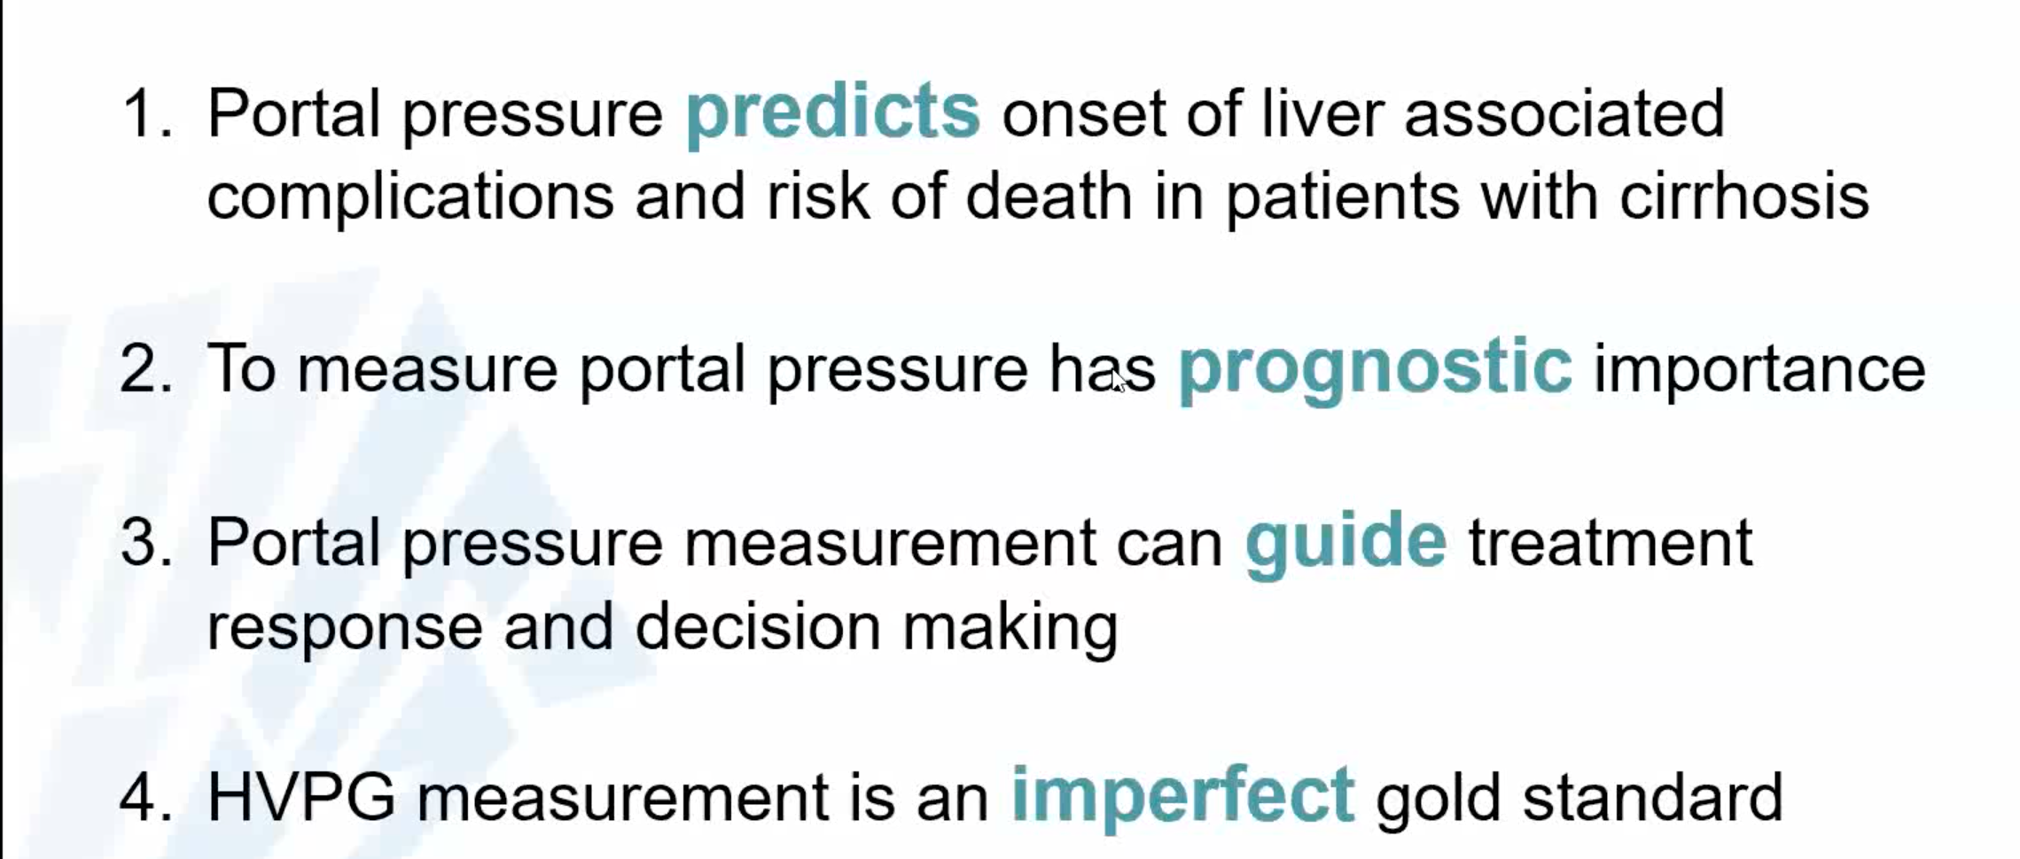
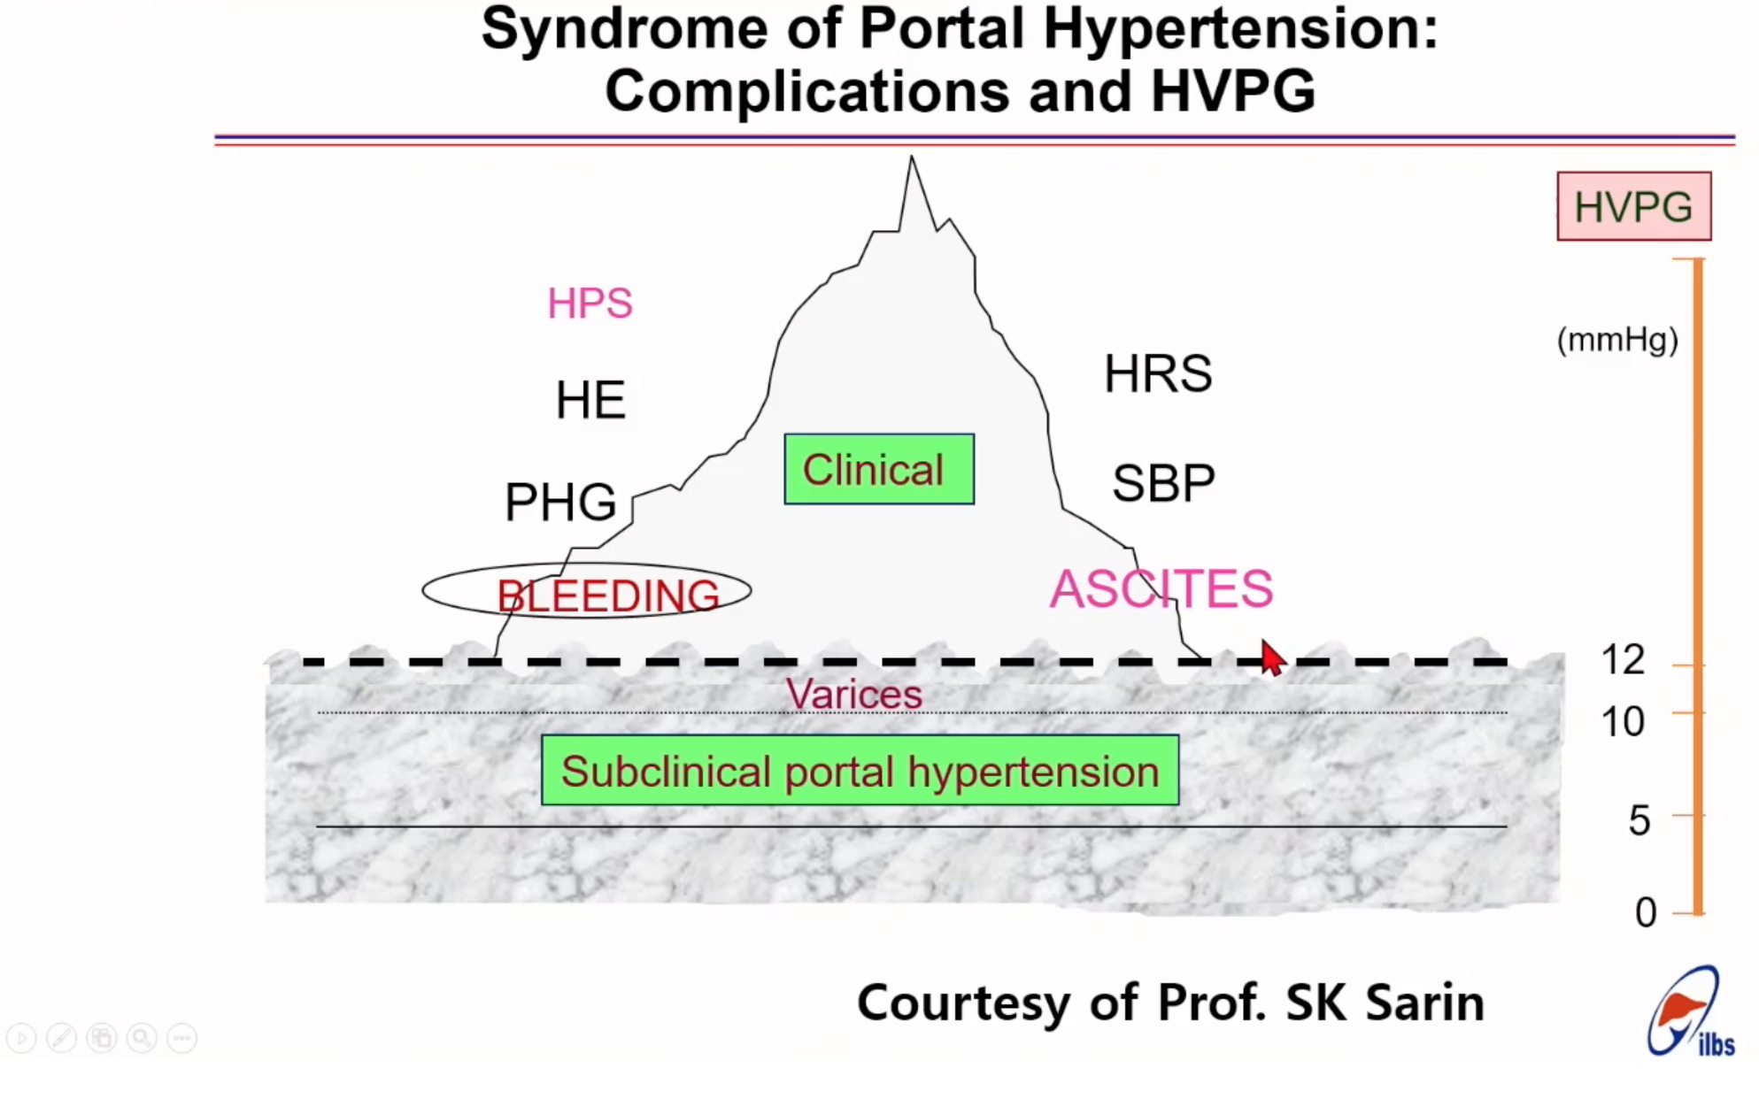
Key principles

Slide 13
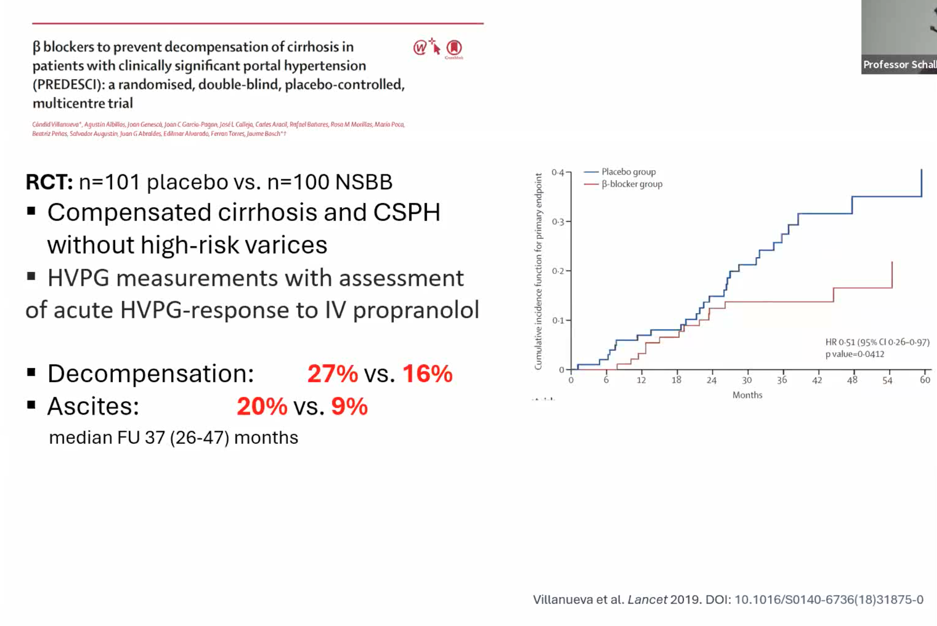
Why measure portal pressure (clinical context)
Portal hypertension (PHT) drives complications in compensated advanced chronic liver disease (cACLD).
Clinically significant portal hypertension (CSPH) = HVPG ≥ 10 mm Hg — best biomarker for predicting decompensation, HCC and death.
HVPG thresholds with prognostic value: >16 mm Hg (HR ≈ 2.87 for mortality); ≥20 mm Hg identifies very high-risk group (≈44% mortality).
PREDESCI shifted practice toward treating all cACLD patients with CSPH (eg, carvedilol) to prevent decompensation, not just to prevent variceal bleeding.

Slide 14
What is EUS-PPG and how it compares to HVPG (method)
EUS-PPG = direct EUS-guided transgastric measurement of hepatic venous pressure (HVP) and portal vein pressure (PVP) using a fine (25G) needle; PPG = PVP − HVP.
Key difference: EUS-PPG measures both HVP and PVP directly vs HVPG (indirect sinusoidal gradient).
Potential advantages:
more direct measurement,
accessible within routine endoscopy units,
may perform better for presinusoidal and non-cirrhotic causes of PHT (where HVPG underperforms).

Slide 15
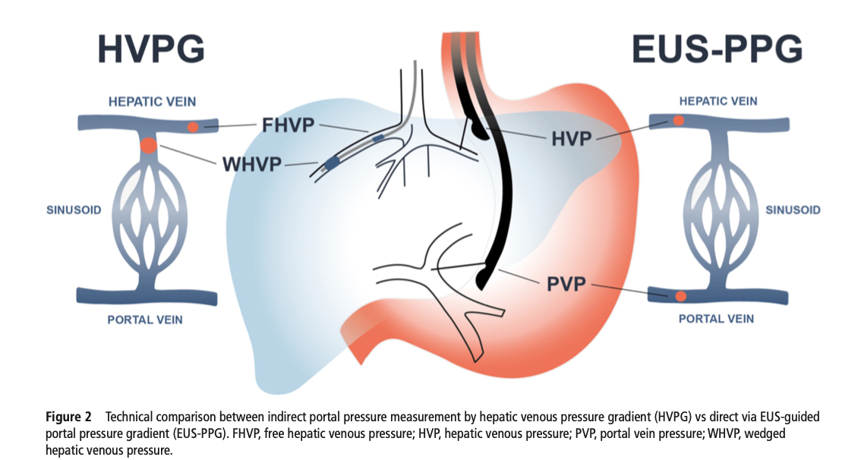

Slide 16
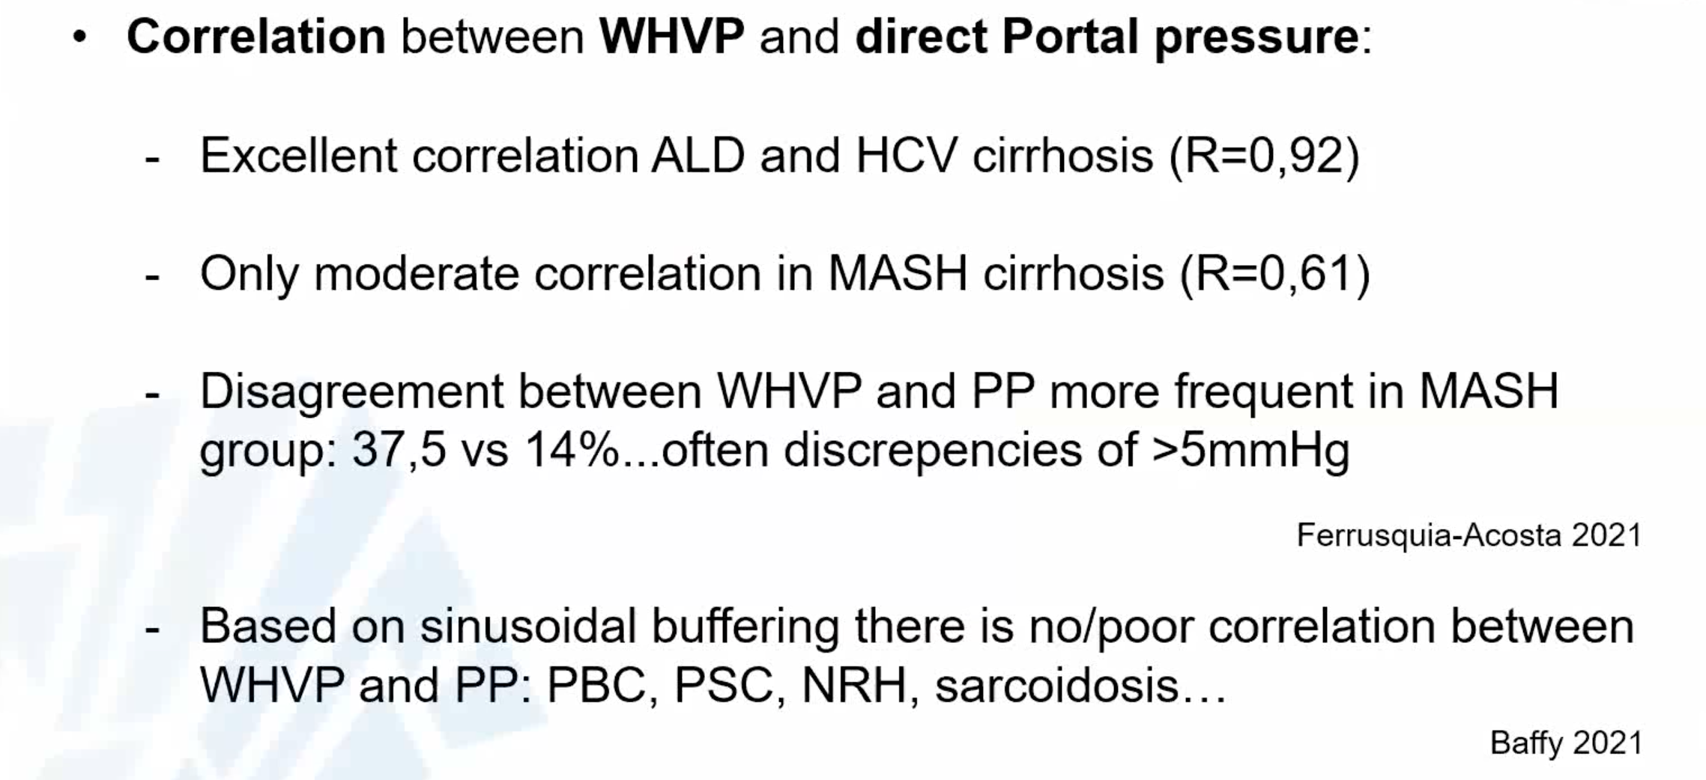
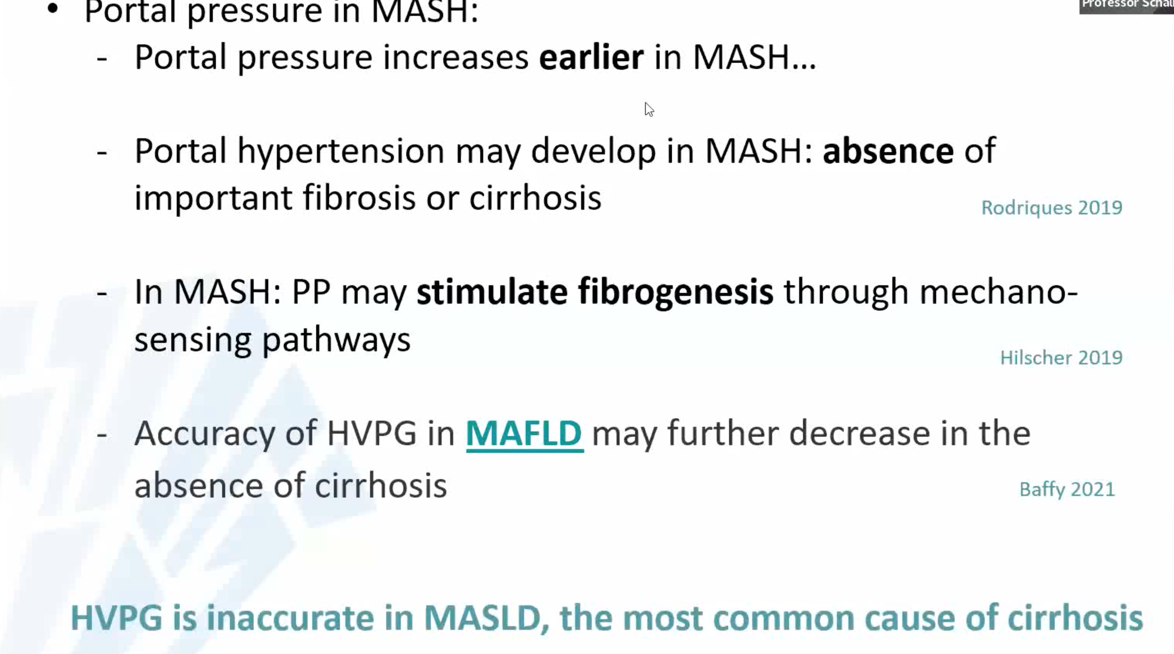
When is HVP measurement unreliable
?? Utility in donor assessment in LRLT (Living related liver donor transplant) programs, were NIT not favorable

Slide 17
Evidence & validation status
Feasibility and safety: initial proof-of-principle and subsequent US cohort studies (mainly MASLD) support technical feasibility and acceptable safety.
GRAPE trial: EUS-PPG correlated well with HVPG (correlation coefficient 0.82) when measured same day/nearby.
ENCOUNTER trial (NCT04987034) results awaited for further real-time validation.
If non-inferiority to HVPG is confirmed, EUS-PPG could increase patient access (endoscopy widely available ??) and be preferred in selected etiologies.

Slide 18
Clinical utility, limitations & implementation considerations
Potential uses:
Identify CSPH for NSBB initiation,
Monitor haemodynamic response to therapy,
Stratify surgical risk (eg, bariatric surgery),
Evaluate PSVD and non-cirrhotic PHT, combine with same-session EUS-LB.
Limitations / cautions:
Not ideal in decompensated patients with large ascites or
Severe coagulopathy (HVPG still superior here).
NITs (LSM/SSM) are rising as first-line: they reduce need for invasive testing but leave a ~35% “grey zone” for cACLD; PSVD diagnostic grey zone may be ~70% — these patients may benefit most from EUS-PPG.
Implementation needs:
procedural standardization, validated platforms, training and competence maintenance (harmonised technique and quality assurance) to avoid underperformance and misleading conclusions.

Slide 19
Summary on EUS PPG measurement
Direct measurement of portal and hepatic vein pressures
Uses transgastric 25G needle
Strong correlation with HVPG (r≈0.82)
Identifies clinically significant portal hypertension (CSPH)
Useful in MASLD and presinusoidal disease
GRAPE Trial 2024; Huang et al., 2020

Slide 20
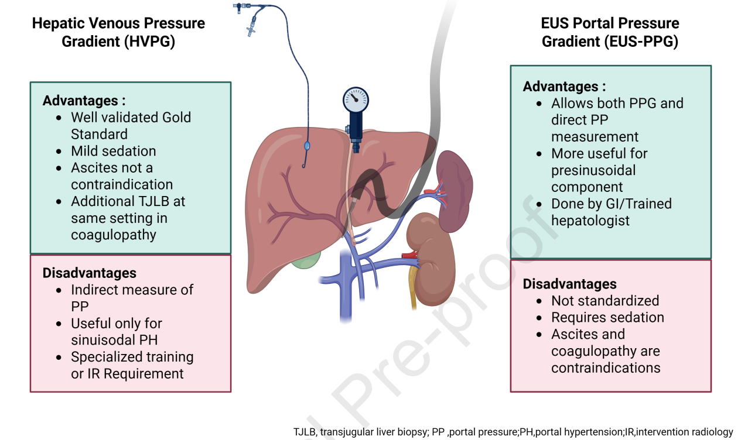

Slide 21
EUS-guided portal vein sampling

Slide 22
Concept & Emerging Diagnostic Utility
EUS provides precise, low-risk access to the portal and hepatic circulation, enabling direct sampling of portal venous blood or thrombus.
This technique is under investigation for:
Improving diagnostic yield and molecular profiling in pancreatic and colorectal cancers.
Identifying biomarkers for metabolic and hepatic diseases.
Portal-venous metabolomics has revealed distinct metabolic signatures in conditions such as hepatocellular carcinoma (HCC), offering insights into tumour development and progression.

Slide 23
Metabolic Research Potential & Future Directions
Portal venous blood holds rich information on pathways involved in alcohol-associated liver disease, MASLD, liver regeneration, and fibrogenesis.
Current research includes metabolomic profiling during bariatric surgery and upcoming studies using EUS-guided FNA (e.g., EUPOR trial).
Given its safety and scientific potential, broader translational research, technical standardisation, and global adoption of EUS-guided portal vein sampling are strongly encouraged.

Slide 24
EUS Elastography (EUS‑SWE)
Shear‑wave elastography performed during EUS
Accurate assessment of liver fibrosis and steatosis
Superior performance in class II–III obesity
Potential alternative to VCTE and MRI‑E
Can measure spleen stiffness as marker of CSPH
RUMIPAMBA Trial ongoing

Slide 25
EUS-Guided Biliary Drainage (EUS‑BD)
Preferred when ERCP fails or in surgically altered anatomy
Techniques include:
– EUS‑guided hepaticogastrostomy (EUS‑HGS)
– EUS‑guided choledochoduodenostomy (EUS‑CDS)
– Rendezvous EUS‑ERCP
High technical success (>90%)
Lower reintervention rates vs PTBD
Paik et al., Gastrointest Endosc 2023

Slide 26
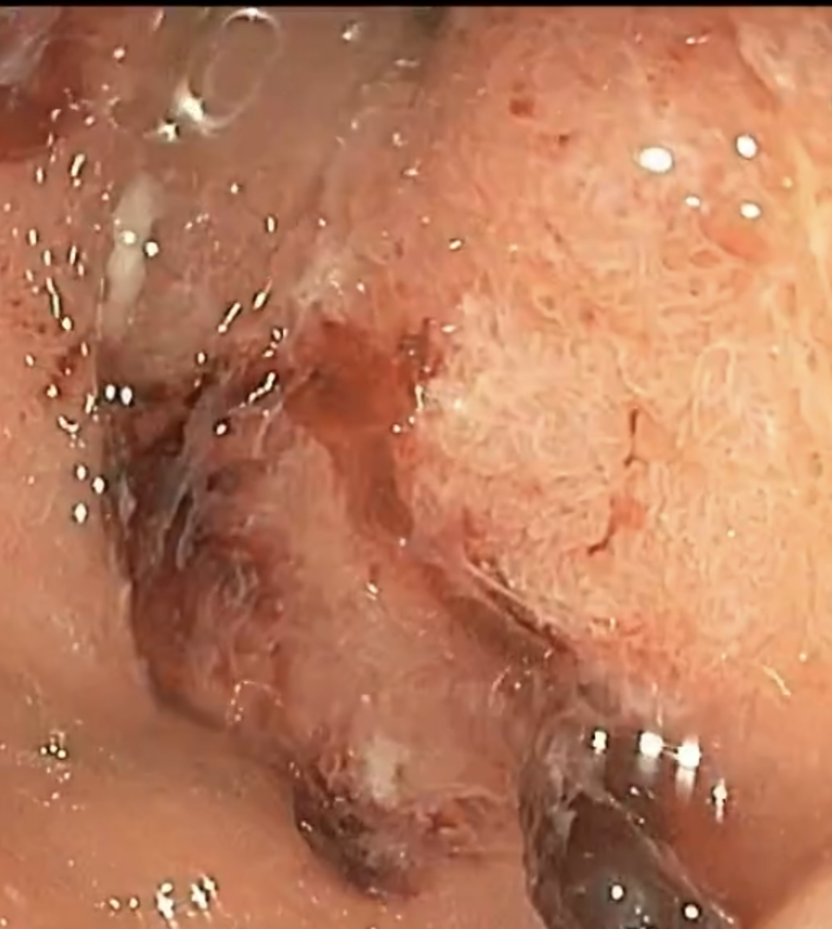
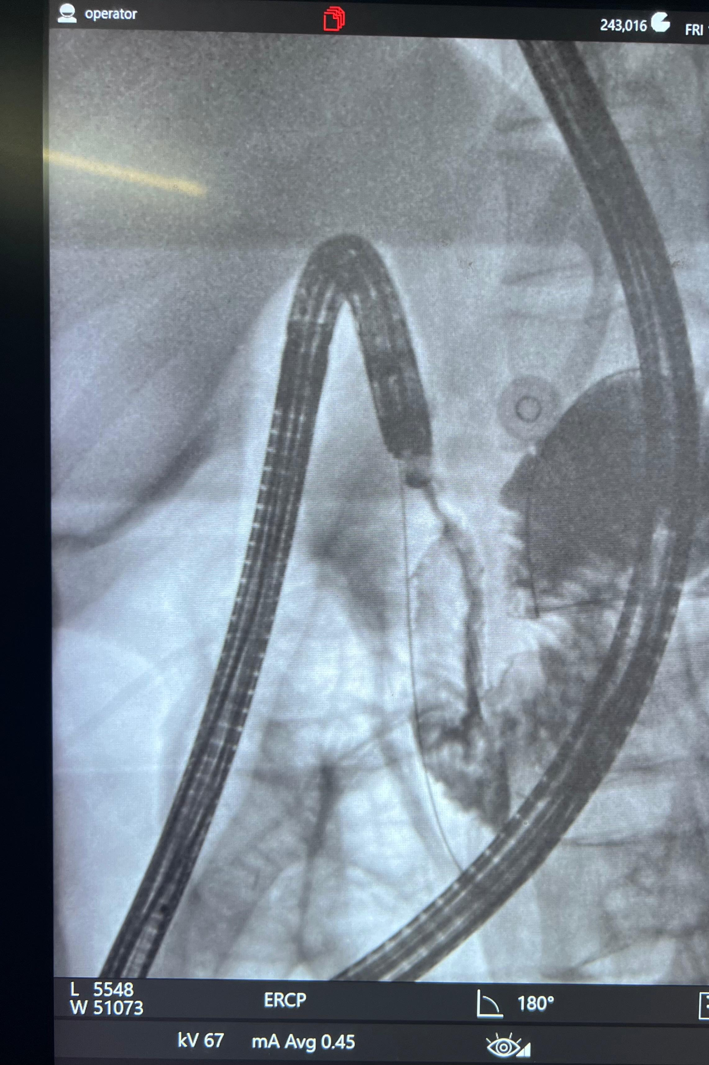
Pin hole complex D1/D2 stricture in patient undergoing ERC for choledocholithiasis

Slide 27
EUS in Variceal Management
EUS‑guided coil + glue therapy for gastric varices
Higher obliteration rates vs endoscopic glue alone
Reduced rebleeding (5–9% vs 17–30%)
Enables Doppler confirmation of flow cessation
Useful for SPSS embolization in refractory encephalopathy
Binmoeller et al., 2011; Rathi et al., 2024

Slide 28
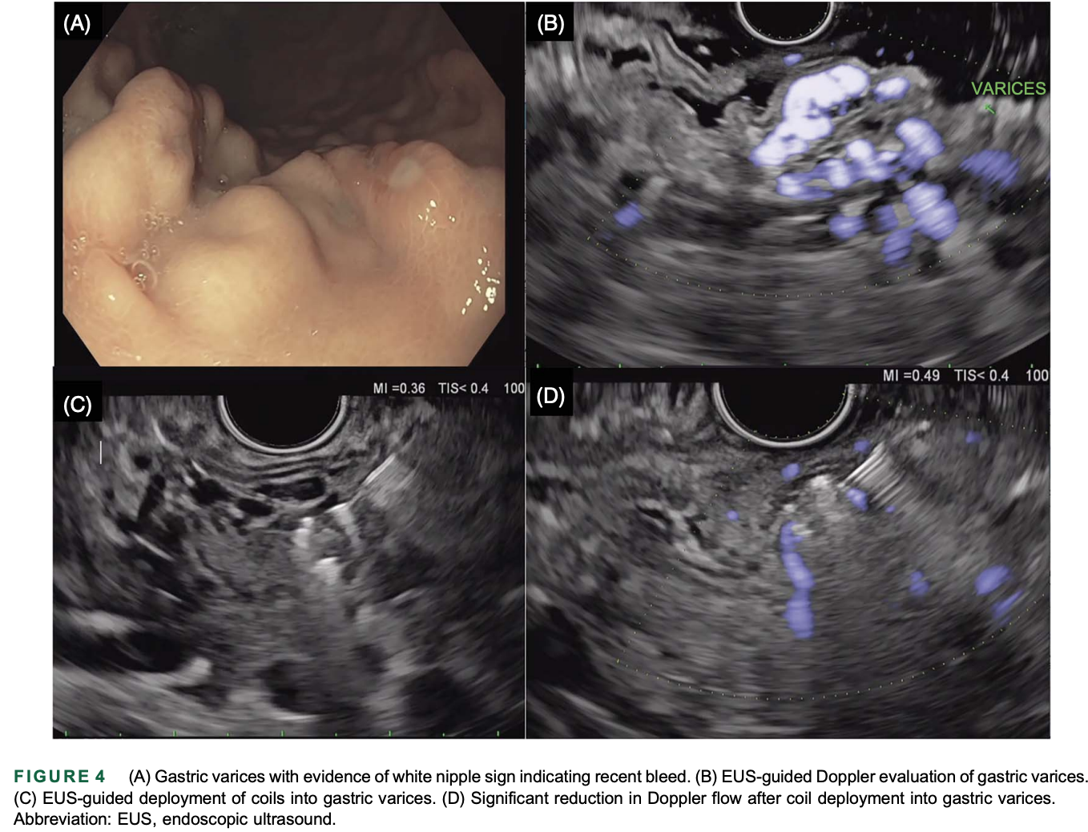

Slide 29
Endoscopic Bariatric & Metabolic Therapies
Emerging therapies for obesity and MASLD
Include:
– Endoscopic sleeve gastroplasty (ESG)
– Duodenal mucosal resurfacing (DMR)
– Duodeno‑jejunal bypass liner (DJBL)
ESG achieves 48–70% excess weight loss
DMR improves HbA1c and liver fat independent of weight loss
MERIT Trial 2022; EMINENT 2023

Slide 30
EUS in Hepatobiliary Disorders
EUS‑guided gallbladder drainage in high‑risk cirrhotics
EUS‑guided management of PSC strictures (adjunct to ERCP)
Assessment of biliary obstruction when ERCP nondiagnostic
Improved safety vs percutaneous drainage
Multicenter Cirrhosis‑GBD Study 2024

Slide 31
Future Directions in Endohepatology
EUS‑guided TIPS creation (experimental)
EUS‑guided tumour ablation and fiducial placement
AI‑enhanced Cholangioscopy (validated)
Integration of metabolic endoscopy into liver care pathways
Vanderschueren et al., Gut 2025

Slide 32
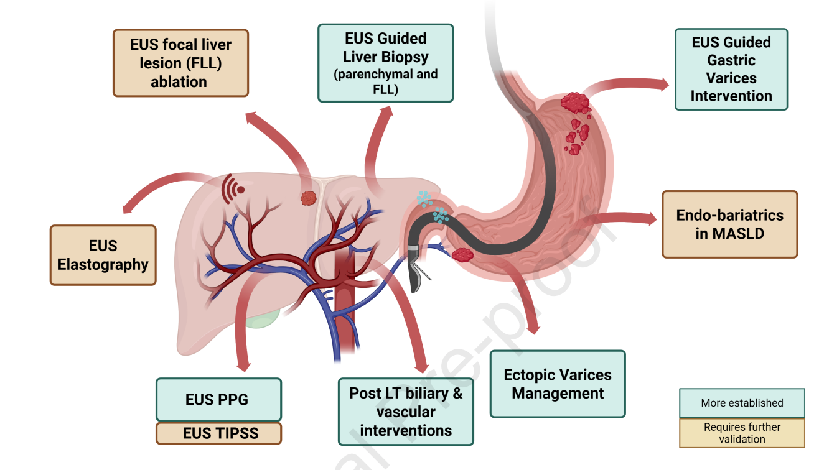

Slide 33
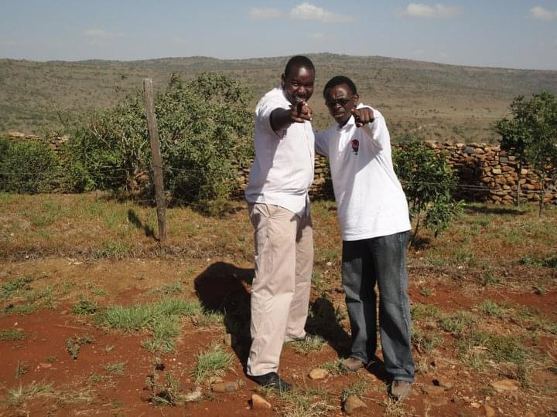
Thank You

